Slide 1
Programming from SCRATCH
A Quick and Easy Guide to Coding!
Presenter: David Paulius
Creativity & Innovation Summer Boot Camp – July 10th, 2021

Slide 2
What YOU will learn today
What is programming or coding?
What can I do with coding?
How can I write code?

Slide 3

What are programming and coding?
So much coding, wow.

Slide 4

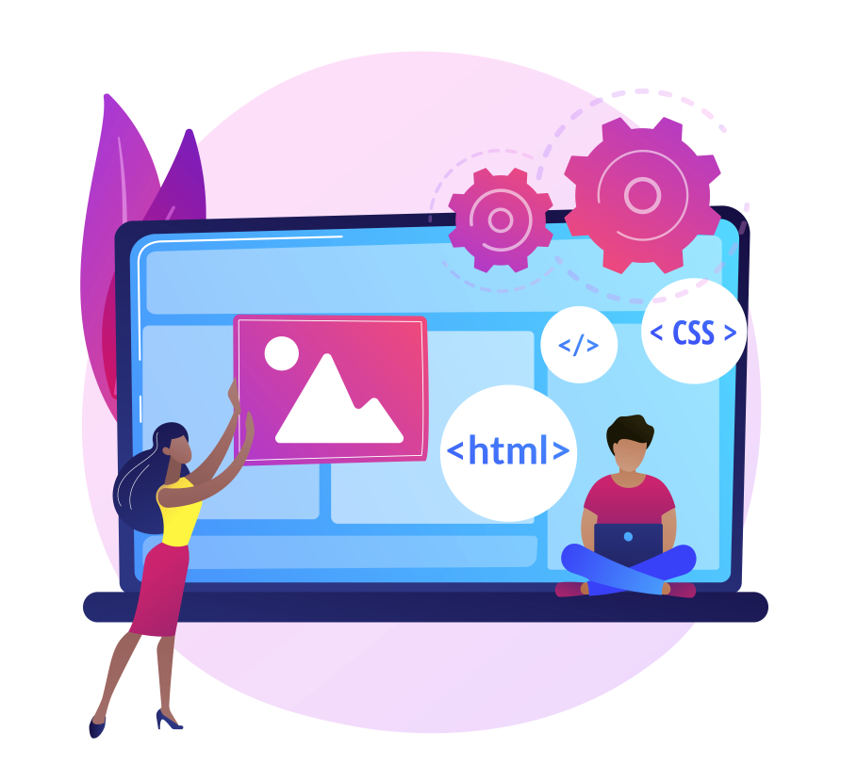
So what is programming anyway?
Computer programming involves creating programs for computers!
Programs are simply made of instructions or commands to:
Solve some kind of problem.
Perform some kind of task.
Make our lives easier!

Slide 5

So what’s programming anyway?
We call those instructions or commands code!
Coding simply means writing code to create a program.
Code has its own language and rules to follow.

Slide 6

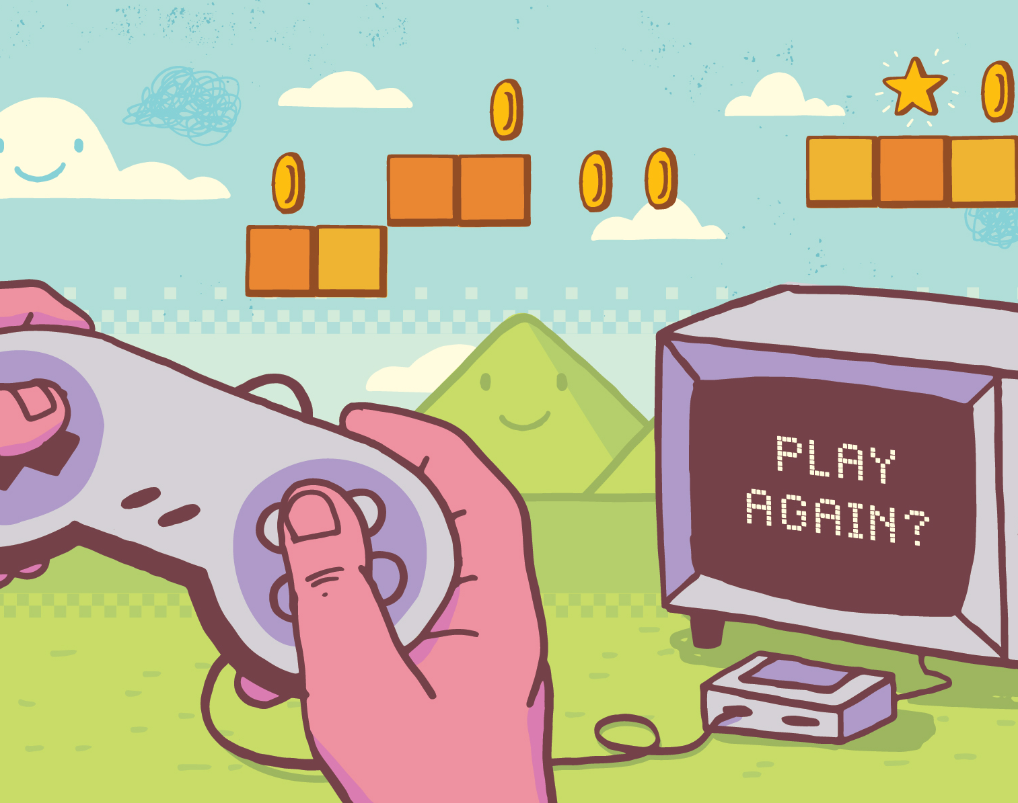
Programming? Where?
We use so many things that are programmed in our daily lives!
Smartphones and apps
Smart devices (e.g. smart watches)
Websites
Video games (lots and lots of it!)
Social media (e.g. Facebook, Instagram)
SO MANY MORE EXAMPLES!

Slide 7

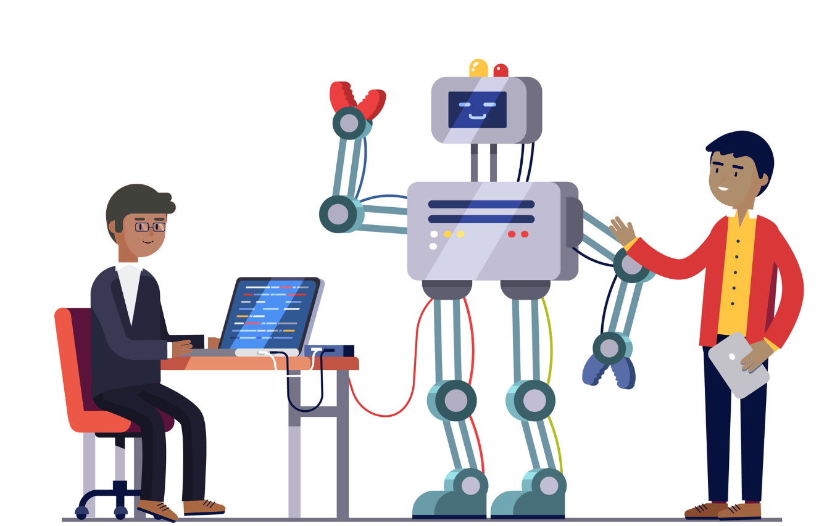
Programming? Where?
There are many careers and fields that need programming.
People can use it for:
Creating games or other products
Designing websites and online content
Automating certain activities
Research
Making cool applications
SO MANY OTHER COOL THINGS!

Slide 8
How can I write code?
We are going to code, wow.

Slide 9
Let’s learn how to code!
Coding sounds cool, right?
Why don’t we try making some simple programs?
We will be coding through the browser!

Slide 10

Let’s learn how to code!
Today, we will be using an environment called Scratch.
A programming environment is a space, program, or platform where we can write code and create programs!
This is a free platform that works through your browser.
You can access it here: https://scratch.mit.edu/.

Slide 11
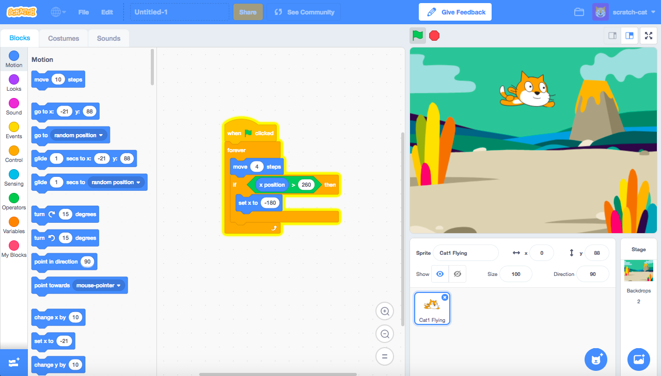
How does Scratch work?
List of instructions or commands
Workspace (where your instructions go)
List of elements in your program
Output Screen
Start/Stop Buttons
Scratch has many parts, wow.

Slide 12
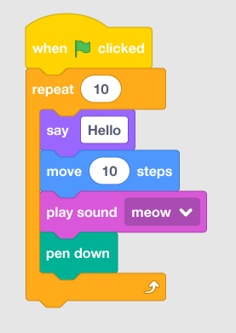
How does Scratch work?
Instructions are in the form of blocks.
There are blocks for many purposes:
Input (asking the user for information)
Output (displaying information to user)
Operators (adding, subtracting, etc.)
Control blocks for:
Logic (true or false, conditions)
Loops (used to repeat instructions)

Slide 13
How does Scratch work?
Event block
You can combine multiple blocks together to create a program.
Think of instruction blocks like Lego!
All programs must begin with an event block.
This says how you start your program.
In the example, it says you can start the program by clicking on the green flag.

Slide 14
Your Tasks…!
In today’s session, we have the following coding tasks:
Saying “Hello” to the Programming “World”!
Quick Maths!
Popping Bubbles!
A VERY Simple Video Game!

Slide 15
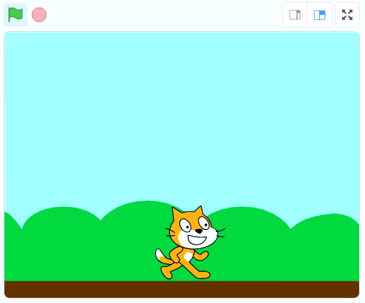
Task 1: Saying “Hello World!”
Every person who first learns how to write code makes a “Hello World” program.
Your task is to write instructions to make Scratch the cat say “Hello World”.
This is how it should look like!

Slide 16
Task 1: Saying “Hello World!”
Your task is to write instructions to make Scratch the cat say “Hello World”.
Hints:
Don’t forget the start block!
Which block has to do with saying something?
This is how it should look like!

Slide 17
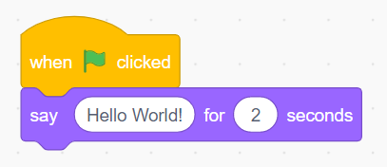
Task 1: Saying “Hello World!”
Connect the say (or think) block to the event block…
… then click on the green flag to start it!

Slide 18
Let’s learn how to code!
This is what we call output.
Output commands are used to tell user about program details or important messages.
Example: you get notifications on your phone or computer when a message comes in.
This is output, wow.

Slide 19
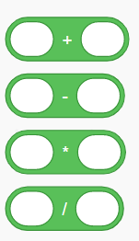
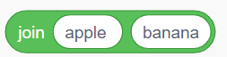
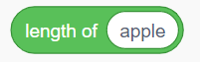
Let’s learn how to code!
Mathematical operators:
Word (string) operators:
Now that we learned about output, let’s learn about another type of instruction: operators.
Operators can be used for:
Arithmetic – maths!
Combining two blocks or words together
Print how many letters are in word or string (a.k.a. length)
* is the same as × / Is the same as ÷
Wow, I love operators.

Slide 20
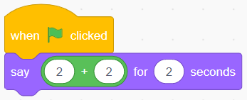

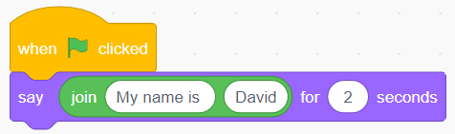
Let’s learn how to code!
Examples of how to use operators:
Print result of 2 + 2:
Print two parts of a sentence:

Slide 21
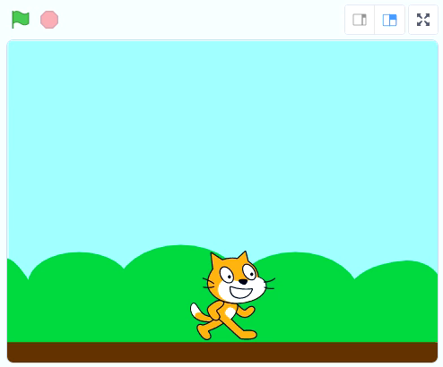
Task 2: Quick Maths!
Next task: you will write code to do some math problems.
You need to solve the following:
191 × 7 = ?
(123 + 456) ÷ 3 = ?
Remember that * is same as ×
This is how it could look like!

Slide 22
Task 2: Quick Maths!
You need to solve the following:
191 × 7 = ?
(123 + 456) ÷ 3 = ?
Hints:
For problem #2, you need to solve the parts in the brackets first and then divide that answer.
You need to output the answers!
How can you combine words and numbers (your answers) together?
This is how it could look like!

Slide 23
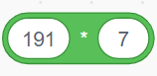
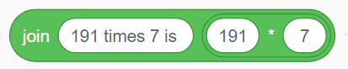
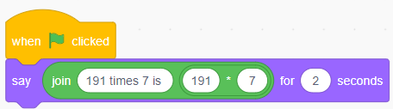
Task 2: Quick Maths!
First, let’s set up the multiplication block:
Next, we need to combine answer with some words: (don’t forget to put a space after “is”)
Finally, let’s output or print the answer:
… and then we get our answer 1337!

Slide 24
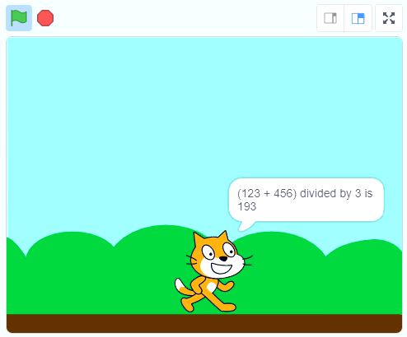
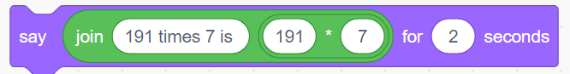
Task 2: Quick Maths!
You need to solve the following:
191 × 7 = ?
(123 + 456) ÷ 3 = ?
Can you solve the second part based on what we did?
This is what it could look like!

Slide 25
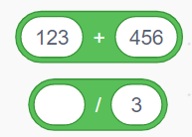
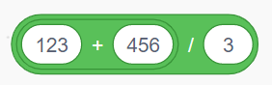
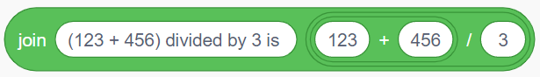
Task 2: Quick Maths!
First, let’s set up the addition and division:
Now, let’s put them together:
Now, let’s add it together with some text:

Slide 26
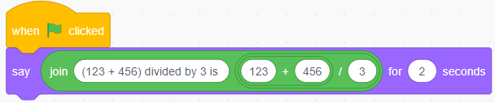
Task 2: Quick Maths!
Now, let’s add it together with some text:
Finally, let’s output or print the answer:
… and then we get our answer 193 !

Slide 27
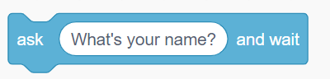
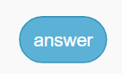
Let’s learn how to code!
Input commands:
The opposite of output is… input!
Input instructions are used to get information from the user.
Example: asking a question like “what’s your name?” and printing the answer.
Stores result
First, output. Now, input? Wow.

Slide 28
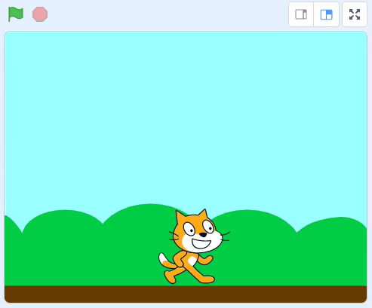
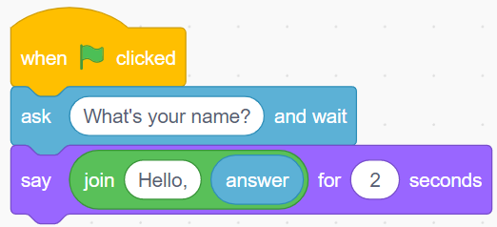
Let’s learn how to code!
Using the ask command with the answer variable…
… we can print out what was given to the program!

Slide 29
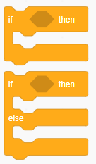
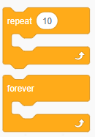
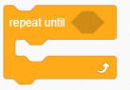
Let’s learn how to code!
Conditional statements:
Loop statements:
Another important instruction type are control instructions, which sometimes rely on conditions.
These are used for many things:
Deciding between choices.
Doing something for some number of times.
Doing something UNTIL some condition is true or false.
Doing something FOREVER.
If coding then fun. If fun, then wow.

Slide 30
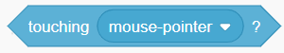
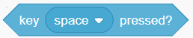
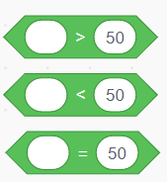
Let’s learn how to code!
Inside of these statements, you can use:
Conditional statements:
Loop statements:
Sensing blocks:
Is mouse cursor touching something (like Scratch)?
Is the space button pressed?
Operator blocks:
Is something is greater than, less than, or equal to something (like number 50)?

Slide 31
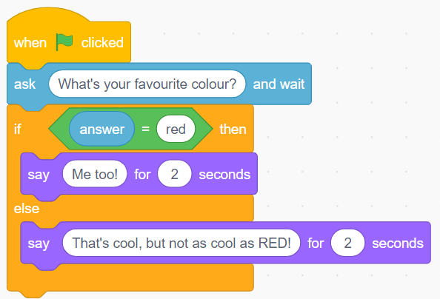
Let’s learn how to code!
Using the ask command with the answer variable, Scratch asks about your favourite colour…
(We use the equals operator block to check if the answer is equal to “red”)
… and Scratch gives a different answer based on what you say (condition)!

Slide 32
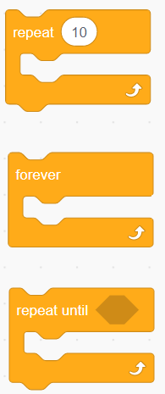
Let’s learn how to code!
Loops are useful to do something repeatedly or to wait until something happens.
Repeat whatever is inside 10 times
Repeat whatever is inside forever (until you stop the program)
Repeat whatever is inside forever until a condition is true

Slide 33
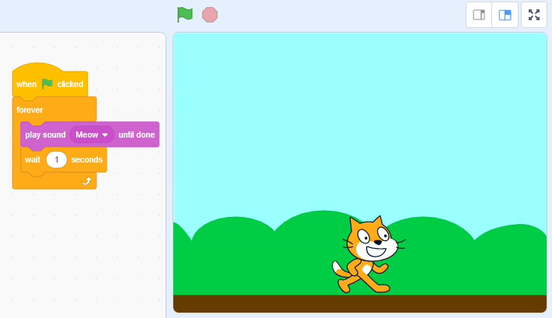
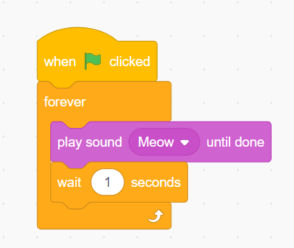
Let’s learn how to code
By using the forever block, we make whatever goes inside repeat forever…
Here, we make Scratch the cat meow until we make the program stop (using stop button).

Slide 34
Task 3: Popping Bubbles!
Next task: we are going to write a simple program to pop bubbles.
If you press the space button, a bubble popping sound will play.
You need to write code that will keep running forever.
This is what you could get!

Slide 35
Task 3: Popping Bubbles!
If you press the space button, a bubble popping sound will play.
Hints:
You need to write code that will keep running forever.
What condition block can be used to tell if the space button is pressed?
You can add a say block before the popping sound (change to 0.1 seconds).
This is what you could get!

Slide 36
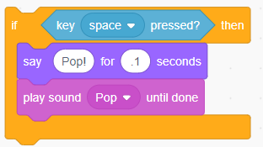
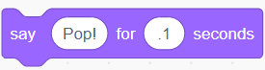
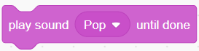
Task 3: Popping Bubbles!
First, we make a condition block, where it checks if the space button is pressed:
We can add a part for Scratch to say “Pop!” :
This is what you could get!
Now we add a block to play the Pop sound:

Slide 37
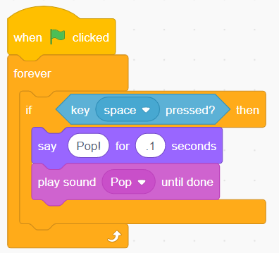
Task 3: Popping Bubbles!
Now, we add this part inside of a loop:
And finally we get this! Try it yourself if you did not get this done.

Slide 38
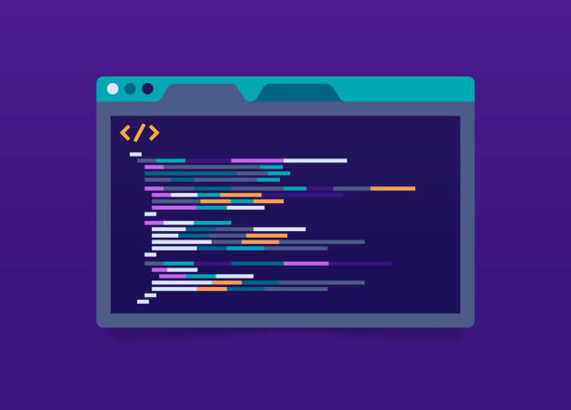
Let’s learn how to code!
We learned quite a lot so far..
Output blocks can be used to give information to a user.
Input blocks can be used to give information to a program.
Control blocks can be used to check if certain conditions are true or false.
Loops can be used to keep a program running under certain conditions.

Slide 39

Let’s learn how to code!
How about video games?
We can use control and button pressing to check if a player presses direction keys to move.
Output can be used when a player needs to read quest information or instructions on how to play.

Slide 40
Task 4: A Very SIMPLE Video Game!
Final Task: we are going to add some code to make a game work!
First, you will need to load the file with the starting code:
Click “File”.
Select “Load from your computer”.
Select the file you should have gotten named “task_4.sb3”.

Slide 41
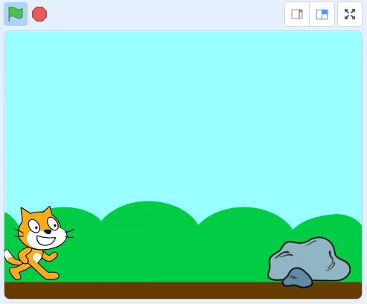
Task 4: A Very SIMPLE Video Game!
You will need to make Scratch the cat move around the scene.
He can move left and right using the arrow keys…
He can also jump if you press the space button!
When he jumps, he meows.
This is what you could get!

Slide 42
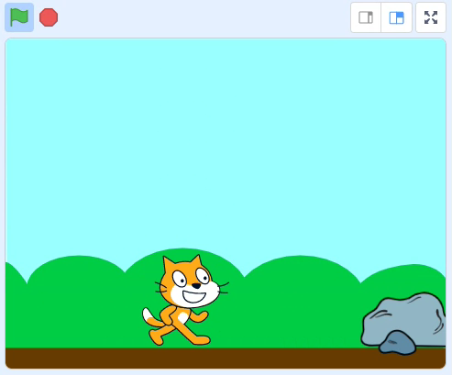
Task 4: A Very SIMPLE Video Game!
However, Scratch needs to be careful! There are dangerous moving rocks in his way!
If he touches a rock, then he will say “Ouch!”.
If the player presses the X button, everything should stop.
This is what you could get!

Slide 43
Task 4: A Very SIMPLE Video Game!
Hints:
There are conditions missing in the if-statements. What has to go inside them to make the jumping and moving work?
What kind of sensing block can be used to check if Scratch is touching the rock?
Where does the meow part go?
How do you stop the loop from running? Is there a button for that?
This is what you could get!

Slide 44
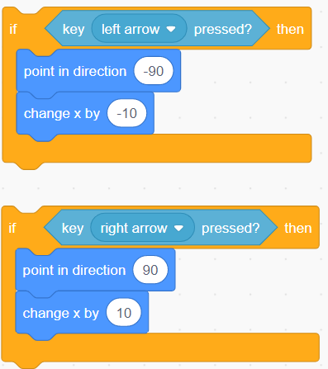
Task 4: A Very SIMPLE Video Game!
First, let’s deal with the directional keys (left and right arrow):
In this game world, the x-direction related to left-right movement…
< 0
0
> 0
Numbers above 0 mean movement in right direction.
Numbers below 0 mean movement in left direction.
So moving left or right means changing the value of x!

Slide 45
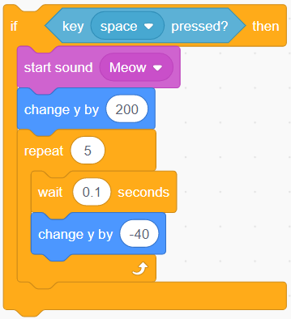
Task 4: A Very SIMPLE Video Game!
Now, we need to deal with jumping… but which direction is jumping?
If x is left-right movement, then y is up-down movement.
> 0
0
< 0
Numbers above 0 mean upward movement.
Numbers below 0 mean downward movement.
So a jump means go up then fall down!
Don’t forget to make him meow!

Slide 46
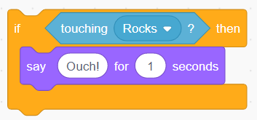
Task 4: A Very SIMPLE Video Game!
Next, we need to deal with when Scratch hits the rocks… Ouch!
We check to see if Scratch is touching the rocks using this block.
Don’t forget to make him say “Ouch”!

Slide 47
Task 4: A Very SIMPLE Video Game!
We add all these parts together…

Slide 48
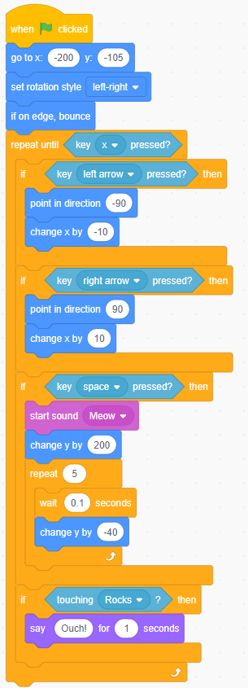
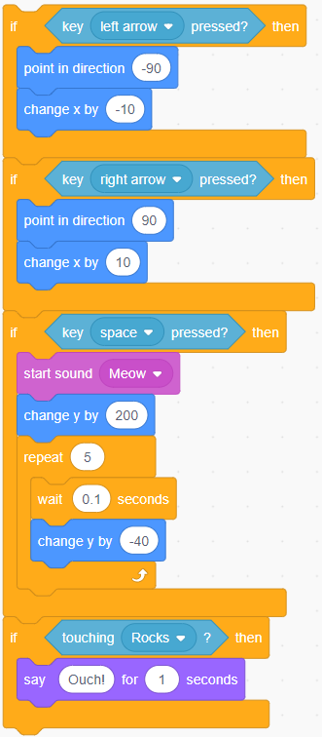
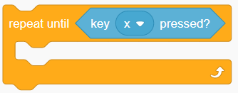
Task 4: A Very SIMPLE Video Game!
… and we put them inside of the repeat until block.
Remember that we need this game to keep going until we press the X button.
Once these parts are together, then we are done!

Slide 49
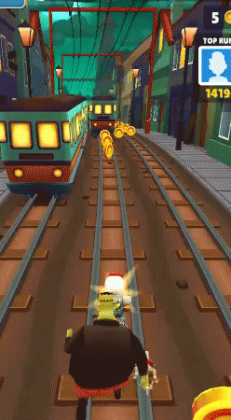

Task 4: A Very SIMPLE Video Game!
We completed a simple video game. Wasn’t that fun?
Games like Subway Surfers, Sonic Dash, or Temple Run use some of these ideas.

Slide 50


Time to Wrap Up!
Today, we talked a little bit about programming.
We learned about Scratch, which is a platform used for learning how to code.
You can find LOADS of projects that other people have made using Scratch here: https://scratch.mit.edu/explore/projects/all

Slide 51

Time to Wrap Up!
There are so many things you can do with programming.
You can be creative, or you can be very technical!
There are lots of problems to solve, and lots of ways you can make your mark on the world!

Slide 52




A Few Famous People in Computing!
Mary Jackson
Katherine Johnson
Dorothy Johnson Vaughan
Alan Turing (Father of AI and CS)
From Hidden Figures movie!
From The Imitation Game movie!

Slide 53




You Ought To Know… (Look ‘em up!)
Andrew Ng (Co-founder Google Brain, AI Researcher)
Jerry Lawson (worked on the first video game cartridge)
Deana Anglin (UX Researcher, Google)
Steve Wozniak (Apple)

Slide 54




You Ought To Know… (Look ‘em up!)
Nancy Douyon (UX Designer, Ethicist)
Timnit Gebru (AI Ethicist)
Inioluwa Deborah Raji
(Researcher, Ethicist)
Joy Adowaa Buolamwini (AI Ethicist)

Slide 55




You Ought To Know… (Look ‘em up!)
Jelani Nelson (Grew up on St. Thomas! Professor at UC Berkeley)
Manuela Veloso (Robotics, AI)
Juan Gilbert (Professor, UF)
Rediet Abebe (Co-founder of Black in AI, Professor at UC Berkeley)

Slide 56




You Ought To Know… (Look ‘em up!)
Valerie Taylor (Argonne National Laboratory, CMD-IT)
Charles Isbell, Jr. (Dean at Georgia Tech)
Ayanna Howard (Dean of Engineering, Ohio State University)
Patrick Hosein (Professor, UWI)

Slide 57
Hope YOU had fun coding!
I may not look like it, but I had so much fun.
Keep calm and code on!

